Slide 1
Unit-2
Basics of
Python Programming
Mr. Nilesh Parmar
Assistant Professor, Dept. of Computer Engg.
UVPCE, Ganpat University, Mehsana

Slide 2
Outline
What is python?
Features and Applications of Python
Python execution process
Python versus other languages
Built-in data types (scalar & non-scalar ) & Type casting
Operators in python
Python syntax and program execution
Indentation, comments and variables
Built-in functions: input & print
String & string operations
Branching statement (if-else) & Control structures (for, while)

Slide 3
Python Programming
It is a high level, interactive, interpreted, object oriented, structured and open source programming language
Inventor: Guido Van Rossum
He named it based on BBC channel’s comedy series: Monty python’s flying circus.

Slide 4
Features of Python
Python is object-oriented
Free and open source
Portable
Provides dynamic typing
Extensible & Embeddable
  Python can be linked to components written in other languages easily
  Python/C integration is quite common
Large number of built-in libraries
Simple syntax and easy to learn

Slide 5
Applications of Python
Creating web, desktop and cross-platform applications
Game development
Creating software prototypes
Scientific & Numeric computing
Artificial Intelligence and Machine learning
Data Science

Slide 6
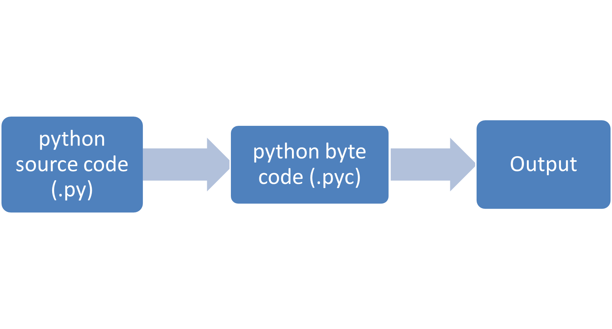
Python Execution Process
Compiler
Python Virtual Machine (PVM)

Slide 7
How python differs from other languages
Declaration of variable is not required, due to implicit and dynamic typing
Indentation is most important. Indentation in branching statement (if-else), loops (for, while), class and function is must
End of statement is not mandatory (;)
Syntax is simple. So, programmer can focus on task instead of coding difficulty.

Slide 8
Binding of variable name with object
In C language
In Python language
Initially int x=2 ;
After sometime x=10;
Initially x=2
After sometime x=10
X
2
10
2
X
label
10
Memory
Memory

Slide 9
Python versions
Python 0.9 was published in 1991
Python 1.0 was released on January, 1994
Python 2.0 was released on October, 2000
  Python version 2.x means 2.0 to 2.7
Python 3.0 was released on December, 2008
  Python3 version 3.x means 3.0 to 3.11
We are going to use python 3.11

Slide 10
Python Data types
Data types
Scalar
Non-scalar
List
Bool
Numeric
None
Tuple
String
int
float
Complex
Octal
Hex
Binary
Dictionary
Set
Frozen set

Slide 11

Data types
A) Numeric types
Integers
Examples: 0, 1, 1234, -56
Floating point numbers
Examples: 0., 1.0, 1e10, 3.14e-2, 6.99E4
Operations involving both floats and integers will yield floats: 6.4 – 2 = 4.4
Complex numbers
Examples: 3+4j, 3.0+4.0j, 2J
Must end in j or J

Slide 12
Contd…
Binary constants
Examples: 0b1011, -0b101
Must start with a leading ‘0b’ or ‘0B’
Octal constants
Examples: 0o177, -0o1234
Must start with a leading ‘0o’ or ‘0O’
Hex constants
Examples: 0x9ff, -0X7AE
Must start with a leading ‘0x’ or ‘0X’

Slide 13
Contd…
B) Bool:
It is used to represent Boolean values: True OR False
Word ‘TRUE’ or ‘true’ is not valid. Use- True
Python is case sensitive language
C) None:
Its value is ‘None’. It shows ‘empty’ or ‘no value’
It has some specific use like when a python function returns nothing, return statement should be: return None
‘None’ is equal to ‘False’, when written inside ‘if’ condition.
  Note: Datatype of a variable can be checked by type() function. For example, c=10
type (c)

Slide 14
Type casting (Type conversion)
int() - constructs an integer number from an integer literal, a float literal (by rounding down to the previous whole number), or a string literal (providing the string represents a whole number)
float() - constructs a float number from an integer literal, a float literal or a string literal (providing the string represents a float or an integer)
str() - constructs a string from a wide variety of data types, including strings, integer literals and float literals
dec(), bin(), oct(), hex() functions are also used for type conversion.
Example: x= int(2.8)
y=float(“4”)
z= str(3.1)
m= int(“7”)
n=float(1)
p= int(“6.5”) # Value Error

Slide 15
Python operators
Basic arithmetic operators
Four arithmetic operations: a+b, a-b, a*b, a/b, a%b
Exponentiation: a**b and Floor division: a//b
Comparison (Relational) operators
Greater than, less than, etc.: a < b, a > b, a <= b, a >= b
Identity tests: a == b, a != b
Logical operators:
logical operators are: and, or , not
Assignment operators:
It includes operators like: =, +=, -=, *=, /=, %=, //=, **=, &=, |=, ^=, >>=, <<=

Slide 16
Contd…
Bitwise operators
Bitwise or: a | b, Bitwise and: a & b
Bitwise not: ~x
Bitwise exclusive or: a ^ b # Don’t get confuse this with exponentiation
Shift a left or right by b bits: a << b, a >> b
Membership operators:
It includes operators: in, not in
Ex: x in y
It in results in True if x is a member of sequence y

Slide 17
Contd...
Identity operators:
It includes operators: is, is not
Ex: x is y
It is results in True if id(x) equals id(y).
Note: 1) Python follows the basic PEMDAS order of operations. Python supports mixed-type math. The final answer will be of the most complicated type used.
For example: (4 + 16 j) /2.2 = (1.81+ 7.27 j)
Complex number is divided by float, resultant data type is complex number.
2) There are NO post and pre increment/decrement operators in python i.e. a++, ++a, --b and b-- type of operators doesn’t exist.

Slide 18
Operator precedence & associativity
Operators | Meaning
() | Parentheses
** | Exponent
+x, -x, ~x | Unary plus, Unary minus, Bitwise NOT
*, /, //, % | Multiplication, Division, Floor division, Modulus
+, - | Addition, Subtraction
<<, >> | Bitwise shift operators
& | Bitwise AND
^ | Bitwise XOR
| | Bitwise OR
==, !=, >, >=, <, <=, is, is not, in, not in | Comparisions, Identity, Membership operators
not | Logical NOT
and | Logical AND
or | Logical OR

Slide 19
Cntd…
Operators of same group have same precedence. When operators of same group exist in an expression, then we need to find out order of their evaluation means which operation will be performed first.
Associativity is the order in which an expression is evaluated that has multiple operator of the same precedence. Almost all the operators have left-to-right associativity.
For example, multiplication and floor division have the same precedence. Hence, if both of them are present in an expression, left one is evaluates first.
Exponent operator ** has right-to-left associativity in Python.

Slide 20
Non associative operators
Some operators like assignment operators and comparison operators do not have associativity in Python. There are separate rules for sequences of this kind of operator and cannot be expressed as associativity.
For example, x < y < z neither means (x < y) < z nor x < (y < z). x < y < z is equivalent to x < y and y < z, and is evaluates from left-to-right.
Furthermore, while chaining of assignments like
x=y=z is perfectly valid, but x = y += z will result into error.
Solve this: 1) a= 4+++--2-8--+++7
2) a= ++9--+-6---3-+++5

Slide 21


Python syntax & Execution of program
Ways to execute python statements/commands:
1) By writing directly in “python command prompt” or in python IDLE:
2) Create a python file with ‘.py’ extension in any editor like notepad / notepad++ / python IDLE / visual studio code etc.
  A) Go to location of that python file & Run it in the command line.
  B) Run that ‘.py’ file using “Run” menu option (or F5 key) in IDLE.
Note:- Before you run ‘.py’ file in command line, add ‘path’ of ‘python.exe’ using ‘Environment Variables’.

Slide 22
Indentation
Indentation refers to the spaces at the beginning of a code line.
In other programming languages the indentation is for better readability only, but in Python it is mandatory.
Python uses indentation to indicate a block of code.
A block means group of statements like if-else, for loop, while loop, class.
Example:
if 5 > 2:
print ("You are inside if statement.")
print("Five is greater than two!")

Slide 23
Comments
Single line comment- use ‘#’
Multiline comment- Python doesn’t have syntax for multiline comment option, but one can use ‘multiline string’ concept to write multiline comments.
Python ignores string literals that are not assigned to a variable, you can add a multiline string (triple quotes) in your code, and place your comment inside it.
Example:
"""
This is a comment
written in
more than just one line
"""
print("Hello, World!")

Slide 24
Variables
In python, variables are just label given to any data value.
A variable is created the moment you first assign a value to it.
Rules for Python variables:
A variable name must start with either an alphabet (A-Z, a-z) or underscore.
A variable name can only contain alpha-numeric characters and underscores (A-z, 0-9, and _ )
Variable names are case-sensitive (age, Age and AGE are three different variables)

Slide 25
Important points
“” and ‘’ works in same way in python.
Multiple variable assignment using single “=“ operator is possible in python.
Ex: 1) x,y,z= 1,2,3
2) a,b,c= “how”
3) m,n,p= “hello” #ValueError
Operator Overloading for ‘+’ and ‘*’:
‘+’= It performs addition when applied to numbers and concatenation when applied to strings.
‘*’= It performs multiplication when applied to numbers, and repetition when applied to ‘number’ and ‘string’.
Swapping of value:
x=2; y=5
x,y=y,x

Slide 26
Cntd…
Overloading of ‘+’operator:
3+4 =7
‘at’ + ‘work’= ‘atwork’
3 + ‘am’ #TypeError
Overloading of ‘*’operator:
3*4 =12
3 * ‘bus’ = ‘busbusbus’
‘at’ * ‘work’ #TypeError

Slide 27
Input function
Input function is used to take input from the user.
By default, it takes input in ‘string’ type. If user wants input in other format, then type casting is required.
Example:
a= input(‘Enter your name:’)
Output→ Enter your name: (waiting for user to input)
Enter your name: hello
Now, a= “hello’
2) A = float (input (‘Enter your age:’))
Output→ Enter your age: 5
A= 5.0

Slide 28
Print function
It is used to display output. There are some variants of print function:
print (‘Hello buddy’)
print(“I don’t know”) OR print(‘I don\’t know’)
x=3
print(“value of x:” +x) # Type Error
To solve this error:
A) Use type conversion. i.e. print(“value of x:” +str(x))
B) Take different values as different parameters
print(“value of x:”, x)

Slide 29
Cntd…
Buit-in parameters of print(): sep, end
1) sep : Data items are separated using value of ‘sep’. Default value is- ‘ ‘ (white space)
Ex: print(‘how’, ’are’, ‘you’, 10,sep=‘$’)
Output→ how$are$you$10
2) end: Value of this parameter is printed at last.
By default, ‘print’ uses end=‘\n’ (new line) character. That means every ‘print’ function leave the cursor in next line. That format can be changed by providing different value to ‘end’.
Ex: print (‘Indian culture’, end=‘’)

Slide 30
Cntd…
Print() is also used to provide formatted output:
print("Art: %5d, Price per unit: %8.2f" %(453,59.058))
Output→ Art: 453, Price per unit: 59.06
2) print("First argument: {0}, second one: {1}".format(47,11))
Output→ First argument: 47, second one: 11
3) print("First argument: {}, second one: {}".format(47,11))
Output→ First argument: 47, second one: 11
4) print ("Second: {1:3d}, first: {0:7.1f}".format(47.42,11))
Output→ Second: 11, first: 47.4

Slide 31
Python strings
String is a sequence of characters i.e. array of characters.
Python does not have a character data type, a single character is simply a string with a length of 1
‘oxe’ and “oxe” both have same interpretation.
Assigning value to a string:
single line: x= ‘hello’
Multiline: x= ‘’’hello how are you?
I am fine.
How is your goal?’’’
String is ‘immutable’ data type.

Slide 32
String: Indexing and Slicing
A string has indexes running from 0 to len(s)-1.
len() is built-in python command to find length of string.
Python also supports negative indexing. Last element of string is indexed as (-1).
For example: H E L L O W O R L D
Consider a= ‘Ganpat University’
print(a[3]) → output: ‘p’
print (a[-6]) → output: ‘e’
-10 -9 -8 -7 -6 -5 -4 -3 -2 -1

Slide 33
Cntd…
Slicing: Fetching a range of characters from string
syntax-1: a[starting_value : end_value]
For example, a= ‘Indian Culture’
print ( a[2:5]) → output: ‘dia’ (it prints a[2: (5-1)] only)
print (a [-5:-2]) → output: ‘ltu’
Syntax-2: a[starting_value: end_value: step-size]
Example: a= ‘computer engineering’
print (a[0:5:2])→ output: 'cmu’
print(a[-6:-1:2])→ output: ‘'ern’
Print(a[1: :3]) → output: 'ournnrg'

Slide 34
cntd…
print (a[-1:-3]) ← Find values of all statements
print (a[-4:-1])
print (a[-1:-3:2])
print (a[-1:-5:-1])
print (a[-1:-5:-2])
print (a[-6:-1:1])
print (a[-6:-1:2])
print (a[-5::2])
print (a[-5::-2])
print (a[:-2:1])
print (a[:-2:-1])
print (a[-3::2])
print (a[-3::-2])
print (a[::2])
print (a[::-3])

Slide 35
String operations
Read provided ms-word document named as “Python_string_methods”.

Slide 36
Conditional Statements (Decision making)
Remember, python doesn’t have ‘switch’ statement.
1) Simple if…else
Syntax:
if expression:
statement(s)
else:
statement(s)

Slide 37
Cntd…
2) if..elif…else ladder:
Syntax:
if expression1:
statement(s)
elif expression2:
statement(s)
else:
statement(s)
3) Nested if..else:
if...elif...else statement inside another if...elif...else statement is called nesting.

Slide 38
Loops
Loop consists of three important parts:
the initialisation, the condition, and the update.
1) while loop:
Syntax:
while expression:
statement(s)
2) for loop:
Syntax:
for iterator in sequence:
statements(s)

Slide 39
Cntd…
Examples:
1) count = 0
while (count < 9):
print ('The count is:', count)
count = count + 1
2) for i in range(5):
print (i)
3) for i in range(1,6,2):
print (i)
4) for i in ‘computer’:
print (i)

Slide 40
Cntd…
break, continue, pass statements & else clause:
break: Terminates the loop statement and transfers execution to the statement immediately following the loop.
continue: Causes the loop to skip the remainder of its body and continue with next iteration.
pass: The pass statement in Python is used when a statement is required syntactically but you do not want any command or code to execute.

Slide 41
Cntd…
Examples:
1) for i in range(6):
if i==3:
break
print(i)
2) for i in range(6):
if i==3:
continue
print(i)
3) while True:
pass
4) class MyEmptyClass:
pass

Slide 42
Cntd…
Else: else clause runs when no break occurs.
Example:
for n in range(2, 10):
for x in range(2, n):
if n % x == 0:
print(n, 'equals', x, '*', n//x)
break
else:
print(n, 'is a prime number')

